Slide 1


Tools for the numerical simulation with complex chemistry Open-source code CANTERA
Tuesday 16th November 2020

Slide 2
Organisation of the day
9h30 – 10h30 : Talk about Cantera (J.W)
10h30 – 12h30 : jupyter notebook tutorial (J.W + T.O)
12h30 – 14h : Lunch break (yourself :D)
14h – 14h15 : Talk about cantera-avbp features (J.W)
14h15 – 17h : end of jupyter notebook tutorial + create your own script (J.W + T.O)
Everything will be on teams.

Slide 3
Why studying chemistry at CERFACS ?
Pollutants
Chemistry driven processes
Ignition
Fuel addition

Slide 4
Content of the presentation
Presentation of CANTERA
Governing equations and numerical methods
Practical use
Installation

Slide 5
Content of the presentation
Presentation of CANTERA
What is CANTERA ?
What can it do ?
Why is it a good choice ?
How will it be helpful to you ?

Slide 6
What is CANTERA ?
CANTERA is an open-source suite of tools for problems involving chemical kinetics, thermodynamics, and transport processes.
Multiple Interfaces
Python
Matlab
C/C++
Fortran 90.
Broad Applications
Combustion
Detonations
Electrochemical energy
Conversion and storage
Fuel cells
Batteries
Aqueous electrolyte solutions
Plasmas
Thin film deposition
Automative
Users can efficiently incorporate chemistry, thermodynamics and transport.
Object-Oriented
Can use different phase without too much change
Notes:
Automation : It automates the chemical kinetic, thermodynamic, and transport calculations so that the users can efficiently incorporate detailed chemical thermo-kinetics and transport models into their calculations.
Object-oriented : Cantera utilizes object-oriented concepts for robust yet flexible phase models, and algorithms are generalized so that users can explore different phase models with minimal changes to their overall code.
Multiple interface : Cantera can be used from Python and Matlab, or in applications written in C/C++ and Fortran 90.
Broad applications : Cantera is currently used for applications including combustion, detonations, electrochemical energy conversion and storage, fuel cells, batteries, aqueous electrolyte solutions, plasmas, and thin film deposition.

Slide 7
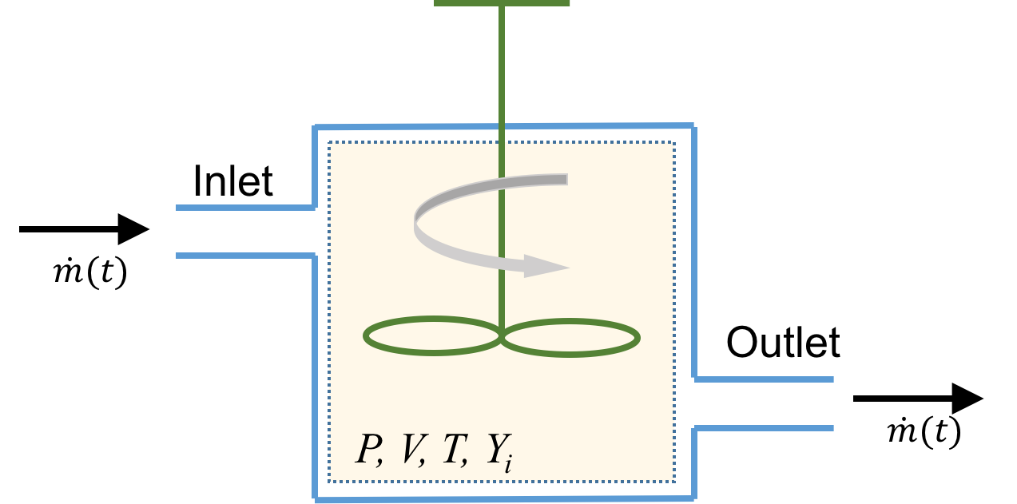
What can CANTERA do?
In terms of calculations …
Initialize a mixture (tutorial part 1)
0D (tutorial part 2)
Equilibrium state
0D with time evolution (tutorial part 3)
Constant Pressure/Volume batch reactor
Steady-state Plug Flow Reactor (PFR)
Notes:
Cantera can perform 0D simulation :
- Equilibrium calculations
- Time evolution of some mixtures

Slide 8
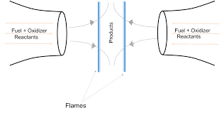
What can CANTERA do?
…
1D (tutorial part 4)
Burner stabilized and propagating premixed flat flame
Diffusion flame in counterflow configuration
Premixed flame in counterflow configuration (strained)
Notes:
CA can perform 0D simulation so equ cal & time evol of closed and open reactors
It can also perform STEADY 1D simulations, mostly premixed configurations but a counterflow diffusion flame model is also implemented
recently it also became possible to add surface ..

Slide 9
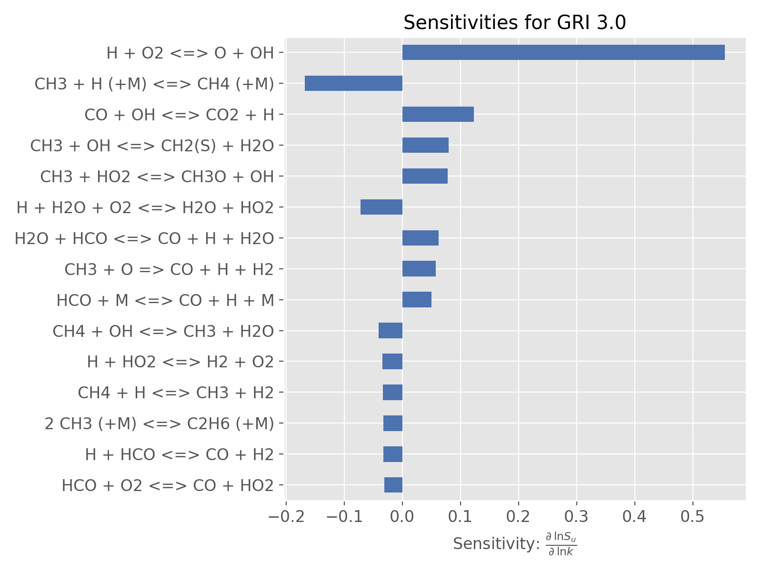
What can CANTERA do?
… but also in terms of analysis !
Data extraction and post processing:
Temperature, Pressure, Mass Fractions …
Path Flow analysis, sensitivity analysis
Add surface chemistry and heat losses …
Notes:
----- Notes de la réunion (12/11/2014 12:11) -----
CA can perform 0D simulation so equ cal & time evol of closed and open reactors
It can also perform STEADY 1D simulations, mostly premixed configurations but a counterflow diffusion flame model is also implemented
recently it also became possible to add surface ..

Slide 10
What is CANTERA ?
CANTERA’s history
We owe it all to Dave Goodwin, the original developer of Cantera whom made it available under BSD license.
He started off with an extensive overhaul of the CHEMKIN suite …
… to steer the modeling software towards an object-oriented structure with multiple interfaces (C++, Python, Matlab, FORTRAN).
Currently, we are at the version 2.4.0 (but we will use version 2.3 in this training).
Notes:
Let us talk history for a min.
Cantera was originally written and developed by an American Professor from the California Institute of Technology.
He liked the open source movement and started an overhaul of CHEMKIN when it became a for profit software
He also had the idea to steer the software towards an … for more flexibility
and to increase the community of users by allowing several language interfaces

Slide 11
What is CANTERA ?
CANTERA has the advantages of an object-oriented code (info in appendix):
Think of a Lego box : it allows you to form complex kinetic/thermodynamic systems, or networks from a set of « building blocks ».
Each « building block » (or object) represents a well-defined small component of the global structure.
Those « building blocks » are defined and coded in C++, the core language of CANTERA …
… But CANTERA provides a user-friendly interface in Python (or Matlab, or FORTRAN)
Notes:
Now, because Cantera is object-oriented, it is flexible.
How so ? You can perform complex simu, and any simu you can think of, by assembling building blocks
Objects are building blocks.
----- Notes de la réunion (12/11/2014 12:11) -----
10 mn

Slide 12
What is CANTERA ?
Data file
(thermo, transport, mechanism)
Functions on objects
Script file
(Python, C++, …)
CANTERA
Restore a flame
Everything goes through the script
Output (.csv, .png, …)
Notes:
TO SUMMARIZE : you only need 2 files to run CANTERA.
The SCRIPT is at the center of everything.
It interacts with the CODE through functions.
And OUTPUTS are written through the interface language, not by Cantera itself and can be re used

Slide 13
Why is it a good choice ?
CANTERA has most of the functionality of the familiar CHEMKIN-II + additional capabilities (non-ideal phases, multiphase equilibrium, electrochemistry…) See appendix to know more the difference between CANTERA and CHEMKIN.
CANTERA can (re)use CHEMKIN files (libraries, mechanisms …).
Users can interface with Cantera through Python, C++, the Matlab toolbox and Fortran as well : no language excuse !
Those interfaces are only front ends; calculations are done in an optimized, compiled code that is really efficient and fast.
Basically, it is possible to create anything that pops into your head …
Notes:
CANTERA can do all that CHEMKIN II did, and better
For old CHEMKIN users, it is possible to re use previous simulations and datas (mechanisms in particular)
No need to be a C++ expert
CANTERA calculations are faster

Slide 14
Why is it a good choice ?
On the downside : CANTERA does not provide any robust documentation. Basically, everything that exists can be accessed through : http://www.cantera.org
But there is a big community of users, they will help solve all bugs and scripting issues : cantera google group
CANTERA comes with a series of scripts and examples in all of the interface languages : currently in the folder ‘samples’
Notes:
The only problem with CANTERA and most open source software : the lack of documentation.
The silver lining of it all is the big community of users, ready to help and full of good advices.
The guys that answer on the chat room are also developers so they know what they are talking about

Slide 15
How will it be helpful to you ?
1. Validation phase
Compare different chemistries with CANTERA, including skeletal and reduced chemistries, in a fast and efficient way.
¹
P = 3 bars,
T = 500 K
Example of laminar flame speed comparison between different mechanism for C2H4/Air oxydation
P = 3 bars,
T = 300 K
¹ K. Narayanaswamy, G. Blanquart, H. Pitsch "A consistent chemical mechanism for oxidation of substituted aromatic species “. Combustion and Flame, Vol.157 pp. 1879–1898, 2010
Notes:
If you are, like me, a combusionist, CANTERA will mostly help you compare different chemistries.
Use the simu to compare the results various methane mechanisms for ex.
It is possible to do some scheme reduction directly with CA, through sensitivity ana for ex, but it is not very efficient.
Better to extract relevant data and …

Slide 16
How will it be helpful to you ?
1. Validation phase
Simulate chemistry-related combustion features directly
Evaluate the impact of simplified transport model (constant Schmidt number, fitted viscosity …)
Develop and test various combustion models. At CERFACS, we use a flame front thickening option (DTFLES) in our CFD code AVBP
Evaluate the effects of strain on flame behavior: axisymmetric stagnation flows reduce to pseudo 1D simulations (counterflow flames)
Notes:
If you are, like me, a combusionist, CANTERA will mostly help you compare different chemistries.
Use the simu to compare the results various methane mechanisms for ex.
It is possible to do some scheme reduction directly with CA, through sensitivity ana for ex, but it is not very efficient.
Better to extract relevant data and …

Slide 17
How will it be helpful to you ?
Validation phase
Reduce some chemistries
Reduce chemistries
Implement your own via the main script (Sensitivity Analysis, …)
Extract relevant data for post processing with reduction tools (ARCANE)
Notes:
If you are, like me, a combusionist, CANTERA will mostly help you compare different chemistries.
Use the simu to compare the results various methane mechanisms for ex.
It is possible to do some scheme reduction directly with CA, through sensitivity ana for ex, but it is not very efficient.
Better to extract relevant data and …

Slide 18
How will it be helpful to you ?
Validation phase
Reduce some chemistries
Initialization phase for other codes
Use 1D profiles to initialize a simulation (CFD codes such as AVBP at CERFACS)
Use 1D profiles to generate flamelet tables for use in CFD codes (Mutagen at CORIA)
Notes:
If you are, like me, a combusionist, CANTERA will mostly help you compare different chemistries.
Use the simu to compare the results various methane mechanisms for ex.
It is possible to do some scheme reduction directly with CA, through sensitivity ana for ex, but it is not very efficient.
Better to extract relevant data and …

Slide 19
Content of the presentation
Presentation of CANTERA
Governing equations and numerical methods
Practical use
Installation

Slide 20
Content of the presentation
Governing equations and numerical methods
(0D) Equilibrium equations
(0D in time) Usual reactors equations
(1D) Laminar premixed flame equations
Notes:
----- Notes de la réunion (12/11/2014 12:11) -----
18 mn
In this section I will briefly review the equations governing eq calc, reactor's evolution and steady 1D flame as well as the numerical methods implemented in CA

Slide 21
Equilibrium calculations
“The equilibrium state is that corresponding to a minimum of a property called the energy function under specified conditions”
Cantera related pages : https://cantera.org/tutorials/python-tutorial.html / https://cantera.org/tutorials/cxx-guide/equil-example.html

Slide 22
Governing equations Equilibrium equations
“The equilibrium state is that corresponding to a minimum of a property called the energy function under specified conditions”
Several methods exist, based on different energy functions.
Usually, the Gibbs free energy function is used, with two constant quantities
2 different methods exist :
Non-stoichiometric methods where the conservation of mass is treated separately
Stoichiometric methods, more robust but slower
CANTERA tries a non-stoichiometric method first, and turns to a stoichiometric method (VCS algorithm²) if it fails.
¹ C.H.Wong ,“Chemical equilibrium analysis of combustion proudcts at constant volume”, 2001
² Smith, W.R. and Missen, R.W. ”Chemical Reaction Equilibrium Analysis: Theory and Algorithms”, 1982

Slide 23
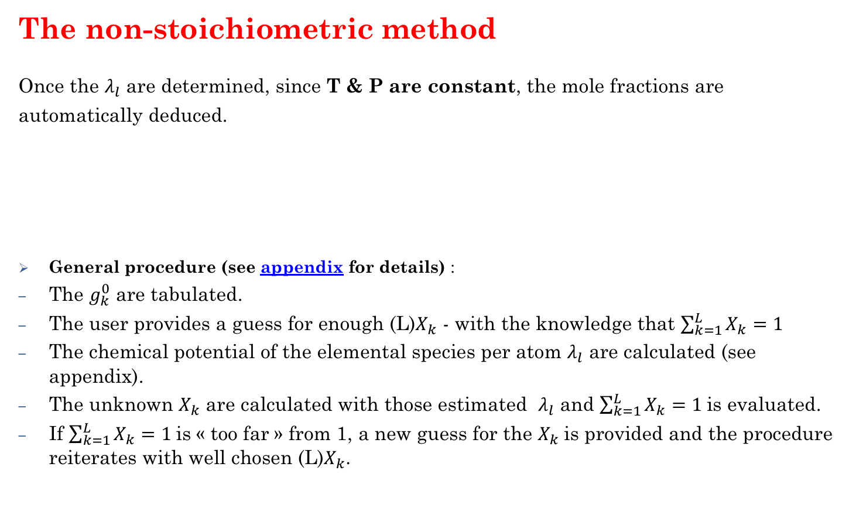
Governing equations Equilibrium equations
The non-stoichiometric method
Once the $λ_{l}$ are determined, since T & P are constant, the mole fractions are
automatically deduced.
General procedure (see appendix for details) :
The $g_{k}^{0}$ are tabulated.
The user provides a guess for enough (L)$X_{k}$ - with the knowledge that $\sum_{k=1}^{L}{X_{k}=1}$
The chemical potential of the elemental species per atom $λ_{l}$ are calculated (see appendix).
The unknown $X_{k}$ are calculated with those estimated $λ_{l}$ and $\sum_{k=1}^{L}{X_{k}=1}$is evaluated.
If $\sum_{k=1}^{L}{X_{k}=1}$is « too far » from 1, a new guess for the $X_{k}$is provided and the procedure reiterates with well chosen (L)$X_{k}$.
Notes:
----- Notes de la réunion (12/11/2014 12:11) -----
You repeat this procedure until you find a set of mole fractions and lagrange multipliers that best satisfy these equations (to a user specified error tolerance)

Slide 24
Governing equations Equilibrium equations
(Note: no need to provide reactions information !)
Adiabatic flame temperature
Equilibrium calculation are also possible maintaining other quantities constant Ex: H and P constant, through a loop on T
Using H at initial conditions
Gives the gas composition and the adiabatic flame temperature.
Notes:
----- Notes de la réunion (12/11/2014 12:11) -----
As I said previously you could maintain other quantities constant besides T and P.
Of interest in combustion is keeping the H and P constant.
If the new enthalpy value is too far from the intial one then you do the procedure again with a new guess for the final T

Slide 25
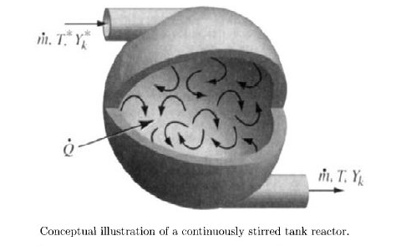
Batch and Stirred Reactor equations³
Initial state
Hydrogen /Air mixture
Initial T
Initial V
Constant P
Adiabatic environment
Air
³ Picture from Robert J. Kee, Michael E. Coltrin and Peter Glarborg ,“Chemically Reacting Flow: Theory and Practice”, 2003 – chap 16
Cantera related page : https://cantera.org/science/reactors.html
Notes:
REACTOR: is a vessel, where species and energy enters, react and get out.
Inside, reactions and transformation occurs. Homogeneous and heterogeneous reactions, as well as heat losses.
The content is supposed to be completely homogeneous, as if mixing was perfect.
----- Notes de la réunion (12/11/2014 12:11) -----
30 mn

Slide 26
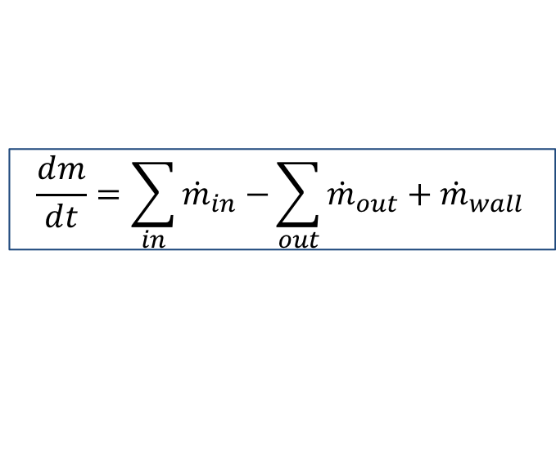
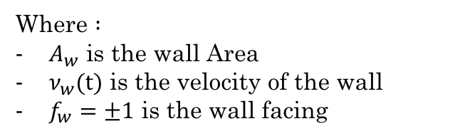
Governing equations Batch and Stirred Reactor³⁴
The state variables for Cantera’s general reactor model are
, the mass of the reactor’s contents
, the reactor’s volume
, the total internal energy of the reactors contents
, the mass fractions for each species
Reactor Volume:
Mass Conservation:
Where $:$
$A_{w}$ is the wall Area
$ν_{w}(t)$ is the velocity of the wall
$f_{w}=±1$ is the wall facing
$$\frac{dm}{dt}=\sum_{in}{{\dot{m}}_{in}−}\sum_{out}{{\dot{m}}_{out}+{\dot{m}}_{wall}}$$
Where are inlets and outlets mass flow rate and stands for the production of homogeneous phase species on the reactor walls.
³ Robert J. Kee, Michael E. Coltrin and Peter Glarborg ,“Chemically Reacting Flow: Theory and Practice”, 2003 – chap 16
⁴ http://cantera.github.io/docs/sphinx/html/reactors.html
Notes:
----- Notes de la réunion (12/11/2014 12:11) -----
The reactor's volume depends upon the walls areas as well as upon the rate at which they move

Slide 27
Governing equations Batch and Stirred Reactor³⁴
The state variables for Cantera’s general reactor model are
, the mass of the reactor’s contents
, the reactor’s volume
, the total internal energy of the reactors contents
, the mass fractions for each species
Species conservation:
Energy Conservation (reactor case) :
Where
is the rate at which species k is generated through homogeneous phase reactions
in the reactor and on the walls
Where is the total rate of heat transfer through all walls
³ Robert J. Kee, Michael E. Coltrin and Peter Glarborg ,“Chemically Reacting Flow: Theory and Practice”, 2003 – chap 16
⁴ http://cantera.github.io/docs/sphinx/html/reactors.html
Notes:
----- Notes de la réunion (12/11/2014 12:11) -----
The reactor's volume depends upon the walls areas as well as upon the rate at which they move

Slide 28
Governing equations Batch and Stirred Reactor³⁴
Resulting system of Ordinary Differential Equations (ODE) :
Usually stiff
Integrated for a user-specified timestep by the Sundials’ solver CVODE.
Gives the temporal evolution of the quantities inside a vessel
³ Robert J. Kee, Michael E. Coltrin and Peter Glarborg ,“Chemically Reacting Flow: Theory and Practice”, 2003 – chap 16
⁴ http://cantera.github.io/docs/sphinx/html/reactors.html

Slide 29
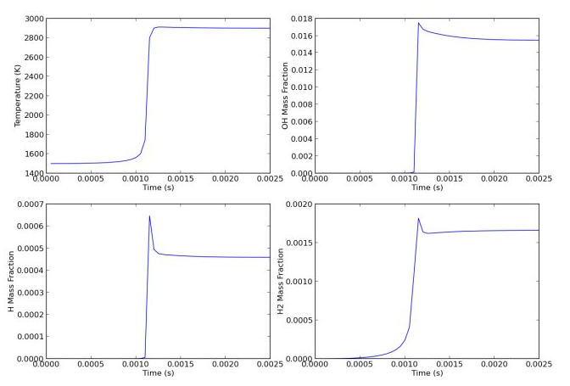
Governing equations Batch and Stirred Reactor³⁴
The constant pressure batch reactor
Initial state
Time evolution of the state with CANTERA
Hydrogen /Air mixture
Initial T
Initial V
Constant P
Adiabatic environment
Ignition
timing
Air
Separating moveable wall, to keep a constant P
A « piston-like » system
³ Robert J. Kee, Michael E. Coltrin and Peter Glarborg ,“Chemically Reacting Flow: Theory and Practice”, 2003 – chap 16
⁴ http://cantera.github.io/docs/sphinx/html/reactors.html
Notes:
Let us take an ex : the constant pressure auto ignition of a mixture of hydrogen. You allow the walls to move so that the mixture keeps a constant P.
Cantera allows you to vizualise the time evolution of the reactor’s content: T, X, energy …

Slide 30
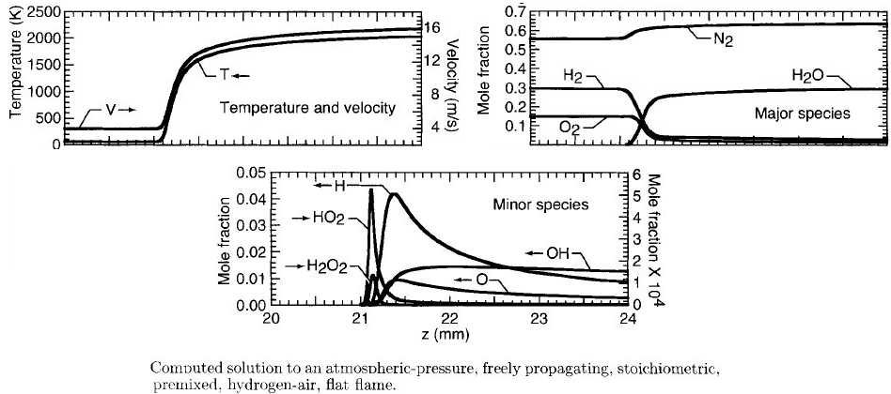
1D computations equations
Example : Laminar premixed flame equations
Picture from Robert J. Kee, Michael E. Coltrin and Peter Glarborg ,“Chemically Reacting Flow: Theory and Practice”, 2003 – chap 3
Cantera related page : https://cantera.org/science/flames.html

Slide 31
Governing equations Laminar Premixed Flame
For a steady laminar premixed flame, we consider 3+K equations, derived from the general conservation equations for perfect gas in cylindrical coordinates³:
Steady-state version
, is the mean molecular weight of the mixture
, is the molar production rate of species k
, is the diffusive mass flux vector of species k
, is the mass averaged specific heat
, is the specific heat of species k
, is the thermal conductivity
, is the spatial coordinate
State
Continuity
Species
Energy
³ Robert J. Kee, Michael E. Coltrin and Peter Glarborg ,“Chemically Reacting Flow: Theory and Practice”, 2003 – chap 16
Notes:
4 state variable, 4 equations.
An eq of state
A continuity eq for the conservation of the mass
A species equation for each species accounting for diffusion and reactions
An energy eq with a term for the thermal conductivity, a term … and a term accounting for the reactions

Slide 32
Numerical Resolution
The steady state version of the previous equations (1D flames) are discretized on a generally non uniform mesh, if needed.
Example with the windward difference in space
Let’s introduce
the discretized solution vector y (density, velocity, mole fractions and temperature at each space point)
the equation vector F (the 3+K conservation equations).
the discretized residual F(y) at each space point.

Slide 33
Governing equations Numerical Resolution
The computational problem consists of finding the smallest residual F, (at all space points j …).
with
A Damped modified Newton solver with internal time integration is used
(but then, transient terms are needed)
Convergence relies on the initial estimate, y⁰,
usually provided by equilibrium calculation
at the inlet temperature T₁⁰ and pressure P₁⁰.

Slide 34
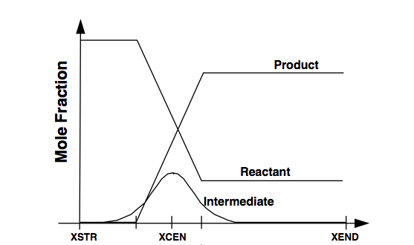
Governing equations Numerical Resolution
An initial y⁰ is required.
Inlet composition, set by user.
Linear profile, inbetween.
Outlet composition, determined by equilibrium calculation.

Slide 35
Governing equations Numerical Resolution
A Damped modified Newton solver with internal time integration
The Newton solver is : the method used by Cantera to solve the system and try to find the solution.
It is damped because a damping coefficient is added to help for the convergence.
It is with internal integration as an “artificial temporal term” is added to help for the convergence if the damping failed.

Slide 36
Governing equations Numerical Resolution
The Newton solver
What we seek at point m is
which is used to iterate
or in other words
Convergence is reached when becomes negligibly small.
The mesh might be automatically refined in the region of high gradients

Slide 37
Governing equations Numerical Resolution
The Damped modified Newton solver
Evaluating the Jacobian matrices
is a time consuming process, so it is not done at each iteration
The solver evaluates the Jacobian each specified number of iteration step and inbetween
Scaling parameter
so that the problem becomes

Slide 38
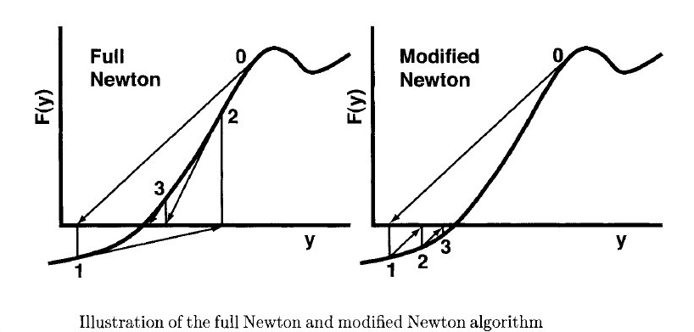
Governing equations Numerical Resolution
The Damped modified Newton solver
x2
x1
x2
x1
(Undamped, λ = 1)

Slide 39
Governing equations Numerical Resolution
The Damped modified Newton solver
The 𝝺^{m} must satisfy the condition that the subsequent undamped step be smaller.
another damping parameter is tested
a new Jacobian is computed
If not verified
set_max_jac_age

Slide 40
Governing equations Numerical Resolution
The Damped modified Newton solver
with internal time integration
Whenever both damping parameters and the new Jacobian fail :
Transient equations are used
Time derivatives are approximated by first-order, implicit backwards finite differences schemes.
Time steps are specified by the user
Same Newton method to solve the system of equations for each time step
The new y is used as a new starting estimate for the steady state problem
set_time_step

Slide 41
Governing equations Numerical Resolution
1. Set a grid of equidistance point
Remeshing
6. Add a point halfway if needed.
Remove some points if unnecessary.
2. Solve with these grid points
5. New refinement is needed
3. Damped modified Newton solver with internal time integration
Solution
4. Compute the temperature slope and curvature
Fails
set_steady_tolerances
set_transient_tolerances
set_refine_criteria

Slide 42
Content of the presentation
Presentation of CANTERA
Governing equations and numerical methods
Practical use
Installation

Slide 43
Practical use
What do you need to run Cantera ?
Data file (.cti,.xml)
Script (.py, .m, …)
Functions on objects
CANTERA
Output (.csv, .png, …)

Slide 44
Practical use
Where do you find the data file ?
From CHEMKIN (‘mech.inp’, ‘therm.dat’ & ‘trans.dat’) via the tool ck2cti.
From a dataset provided with CANTERA (air, GRIMech, …).
You can generate it by hand.
And the script ?
You generate it from « building blocks ».

Slide 45
Practical use
Data file
What is a data file (format ‘.cti’) ?
It contains information about :
Phases and interfaces (species involved, thermo and transport models …)
Elements and species data
Reaction data (expression, rate coefficients, pressure dependence, …)
Appendix gives you information about technical keywords

Slide 46
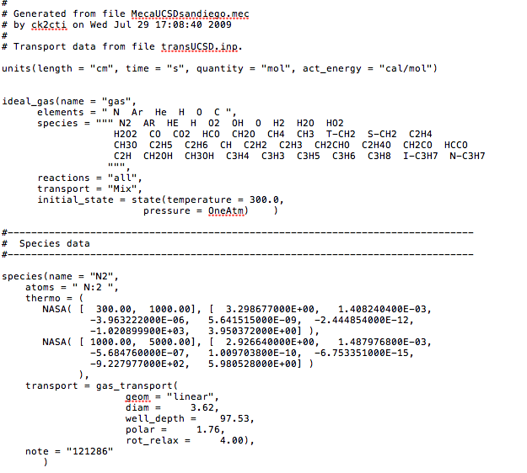
Practical use
Data file
Units
Phase data
Species N₂ data
thermo
transport

Slide 47
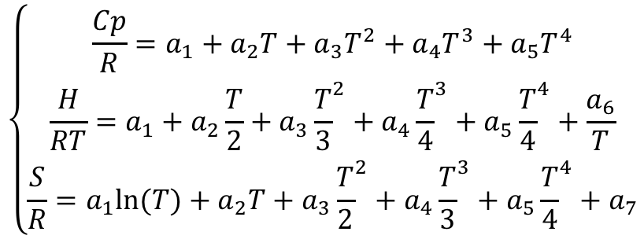
Practical use
Data file
NASA7
There can be other definitions but this one is the most popular.
$$\left\{\begin{aligned}\frac{Cp}{R}=a_{1}+a_{2}T+a_{3}T^{2}+a_{4}T^{3}+a_{5}T^{4} \\ \frac{H}{RT}=a_{1}+a_{2}\frac{T}{2}+a_{3}{\frac{T}{3}}^{2}+a_{4}{\frac{T}{4}}^{3}+a_{5}{\frac{T}{4}}^{4}+\frac{a_{6}}{T} \\ \frac{S}{R}=a_{1}ln⁡(T)+a_{2}T+a_{3}{\frac{T}{2}}^{2}+a_{4}{\frac{T}{3}}^{3}+a_{5}{\frac{T}{4}}^{4}+a_{7}\end{aligned}\right.$$
Cantera link : https://cantera.org/science/science-species.html

Slide 48
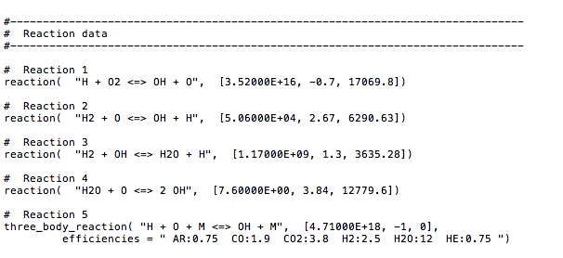
Practical use
Data file
Reactions Data
k_{f} = A T^{b} e^{-E/RT}

Slide 49
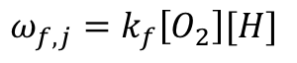
Practical use
Data file
k_{f} = A T^{b} e^{-E/RT}
Depends on the order of the reaction
-
Cal/mol
Here :
$$ω_{f,j}=k_{f}\left[O_{2}\right][H]$$
So the order is 2 and the unit is :
[mol/m³/s]/[mol/m³]² = [mol⁻¹m⁻³s⁻¹]
More data on the type of equations can be found in appendix.

Slide 50
Practical use
Script
Example
The constant pressure batch reactor
It is composed of 5 main « building blocks »
2 Reactors
Methane-air mixture
Non reactive air mixture
Moveable wall
Methane /Air mixture
Air
Separating moveable wall
They form a constant
pressure reactor !
The piston-cylinder system

Slide 51
Practical use
Script
The constant pressure batch reactor
""" Constant pressure reactor ‘.py’ script. """
#Mechanism used for the methane-air mixture
cti = importPhase('gri30.cti')
#Set initial conditions
cti.set(T = 1200, P = 1, X = 'CH4:0.40, O2:1, N2:3.76')
# Create the batch reactor
r = Reactor(cti)
#Create a reactor for the environment containing air at
#atmospheric conditions
env = Reservoir(Air())
# Define a wall between the reactor and the environment, and
# make it flexible, so that the pressure in the reactor is held
# at the environment pressure.
w = Wall(r,env)
w.set(K = 1.0e6) # set expansion parameter
w.set(A = 1.0) # set wall area
# Now create a reactor network consisting of the single batch reactor
# Reason: the only way to advance reactors in time is through a
sim = ReactorNet([r])
What does
it look like,
« program-wise » ?
Building blocks

Slide 52
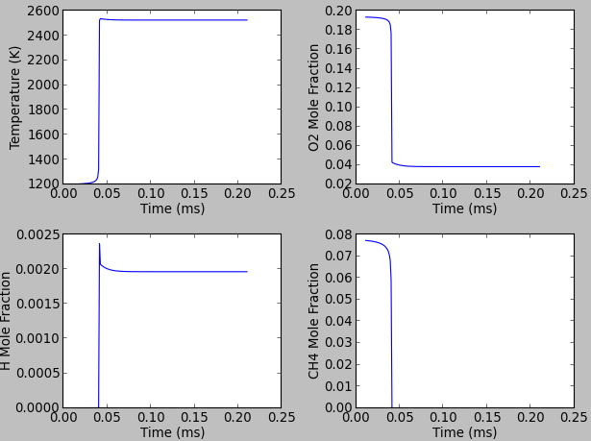
Practical use
Script
The constant pressure batch reactor
What will
you observe ?

Slide 53
Practical use
Helpful links
Github
https://github.com/Cantera/cantera
Google Groups page for Cantera
http://groups.google.com/group/cantera-users
Cantera SourceForge Page http://sourceforge.net/projects/cantera/files/
To download all Cantera versions, source code or (Windows) binaries and find more documentation.

Slide 54
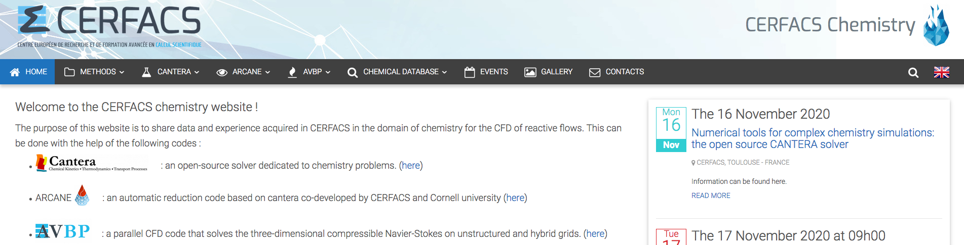
Practical use
Helpful links
CERFACS CANTERA website : https://chemistry.cerfacs.fr
CERFACS knowledge and experience in chemistry for CFD in one website !!!
- Chemical database : Detailed, reduced and global kinetics mechanisms
- Cantera : CERFACS’ version with installation walkthrough, scripts and tutorials
- Private documentation : ARCANE, AVBP
- Events : such as this training
- CFD gallery : nice pictures with great chemistry

Slide 55
Content of the presentation
Presentation of CANTERA
Governing equations and numerical methods
Practical use
Installation

Slide 56
Installing CANTERA
Official versions
You can install CANTERA on both LINUX, Windows and Mac.
To install the official version, instructions can be found here
https://cantera.org/install/index.html
The current version is Cantera 2.4.0.

Slide 57
Installing CANTERA
CERFACS versions
If you are from CERFACS get the sources with
From outside, you can get them from :
https://chemistry.cerfacs.fr/en/cantera-installation/

Slide 58
Installing CANTERA
The advised procedure for a local installation of the CERFACS Cantera version is
The script is only valid for NFS machines installation and Mac OSX installation.

Slide 59
Thank you for your attention !
Any questions ?
Yes, please ask !
No, it’s fine !
Tutorial time !!
Notes:
Let’s detail a little bit the difference bet CA & CH

Slide 60
Appendix
Cantera VS CHEMKIN
Detailed structure of Cantera
Gibbs function
Keywords in the cti format
Equations in the cti
Notes:
Let’s detail a little bit the difference bet CA & CH

Slide 61
1. Cantera VS CHEMKIN
Notes:
Let’s detail a little bit the difference bet CA & CH

Slide 62
Cantera VS CHEMKIN
Its possibilities are comparable to the CHEMKIN-II suite :
CHEMKIN = a set of FORTRAN libraries | CANTERA = a set of C++ libraries
3 input files (thermo / transport / mechanism) | 1 « data file » (everything)
« Interpreter step » to generate the binary input file
A driver to stir the program towards simulations (Keywords) | A script to arrange « building blocks » into a simulation (Interface objects and functions)
Outputs written by the libraries | Outputs generated by the language of the script (Python, C++, Matlab, FORTRAN)
Notes:
Let’s detail a little bit the difference bet CA & CH

Slide 63
Cantera VS CHEMKIN
Its possibilities are comparable to the CHEMKIN-II suite :
CHEMKIN = a set of FORTRAN libraries | CANTERA = a set of C++ libraries
3 input files (thermo / transport / mechanism) | 1 « data file » (everything)
« Interpreter step » to generate the binary input file
A driver to stir the program towards simulations (Keywords) | A script to arrange « building blocks » into a simulation (Interface objects and functions)
Outputs written by the libraries | Outputs generated by the script’s language (Python, C++, Matlab, FORTRAN)
Notes:
The other difference lies in the input files.
Only 1 data file with everything in it and no need for a binary file with CA

Slide 64
Cantera VS CHEMKIN
It’s possibilities are comparable to the CHEMKIN-II suite :
CHEMKIN = a set of FORTRAN libraries | CANTERA = a set of C++ libraries
3 input files (thermo / transport / mechanism) | 1 « data file » (everything)
« Interpreter step » to generate the binary input file
A driver to stir the program towards simulations (Keywords) | A script to arrange « building blocks » into a simulation (Interface objects and functions)
Outputs written by the libraries | Outputs generated by the script’s language (Python, C++, Matlab, FORTRAN)
Notes:
Chemkin relies on Keywords to stir the program towards predefined simulations,
through a text file that is called a driver

Slide 65
Cantera VS CHEMKIN
CHEMKIN KEYWORD INPUT
/ flame configuration, burner stabilized with specified temperature
BURN
TGIV
/ in the event of a Newton failure, take 100 timesteps of 1.E-6
TIME 100 1.00E-6
/ begin on a uniform mesh of 6 points
NPTS 6
/ definition of the computational interval
XEND 10.0
XCEN 5.0
WMIX 10.0
/ pressure and inlet mass flow rate
PRES 0.0329 (atmospheres)
FLRT 4.63E-3 (g/cm**2-sec)
It’s possibilities are comparable to the CHEMKIN-II suite :
CHEMKIN = a set of FORTRAN libraries | CANTERA = a set of C++ libraries
3 input files (thermo / transport / mechanism) | 1 data file (everything)
« Interpreter step » to generate the binary input file
A driver to stir the program towards simulations (Keywords) | A script to arrange « building blocks » into a simulation (Interface objects and functions)
Outputs written by the libraries | Outputs generated by the script’s language (Python, C++, Matlab, FORTRAN)
KEYWORDS
Notes:
Here is an example of a burner stabilized flame simu
Keywords set the P and mass flow rate of the burner for the CH burner simu

Slide 66
Cantera VS CHEMKIN
It’s possibilities are comparable to the CHEMKIN-II suite :
CHEMKIN = a set of FORTRAN libraries | CANTERA = a set of C++ libraries
3 input files (thermo / transport / mechanism) | 1 « data file » (everything)
« Interpreter step » to generate the binary input file
A driver to stir the program towards simulations (Keywords) | A script to arrange « building blocks » into a simulation (Interface objects and functions)
Outputs written by the libraries | Outputs generated by the script’s language (Python, C++, Matlab, FORTRAN)
Notes:
CA relies on its interface. NO predefined CANTERA programs,
A script needs to be written for the simulation you want to perform with this interface
So, objects and functions in a script

Slide 67
Cantera VS CHEMKIN
It’s possibilities are comparable to the CHEMKIN-II suite :
CHEMKIN = a set of FORTRAN libraries | CANTERA = a set of C++ libraries
3 input files (thermo / transport / mechanism) | 1 data file (everything)
« Interpreter step » to generate the binary input file
A driver to stir the program towards simulations (Keywords) | A script to arrange « building blocks » into a simulation (Interface objects and functions)
Outputs written by the libraries | Outputs generated by the script’s language (Python, C++, Matlab, FORTRAN)
""" Burner Stabilized flame ‘.py’ script. ""”
initial_grid = [0.0, 0.0025, 0.005, 0.0075, 0.0099, 0.01]
f = ct.BurnerFlame(gas, initial_grid)
f.burner.T = 400
f.burner.X = reactants
f.burner.mdot = 0.04
OBJECTS
FUNCTIONS

Slide 68
2. Detailed structure of Cantera
Notes:
Let’s detail a little bit the difference bet CA & CH

Slide 69
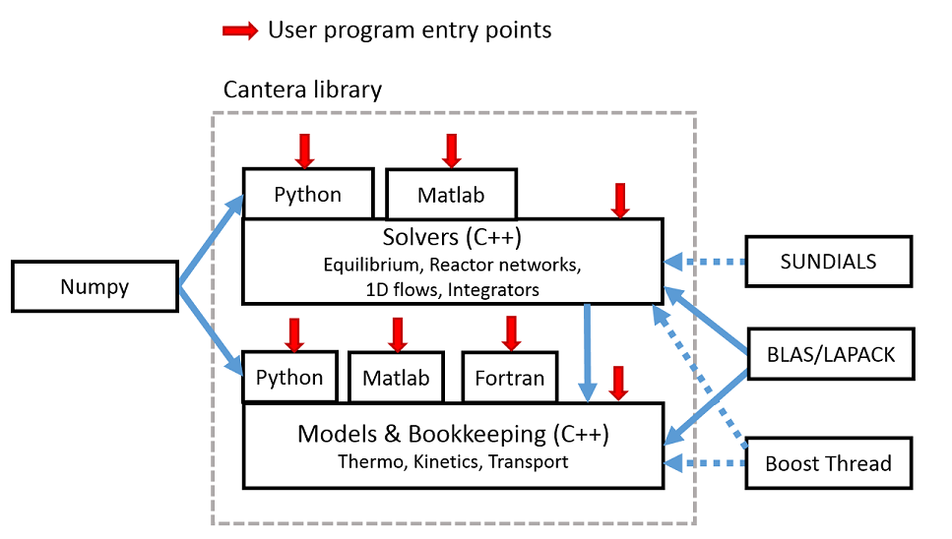
Structure of CANTERA

Slide 70
Structure of CANTERA
The « Solver » layer
Usually hidden from the user, and borrows from famous « free » libraries (LAPACK, BLAS, …) to perform
Equilibrium calculations
Reactor equations integration
1D calculations
…

Slide 71
Structure of CANTERA

Slide 72
Structure of CANTERA
The « Bookkeeping » layer
As we have just seen, it is the python script entry.
This layer contains all the methods that will
Initialize objects defined in the script
If a phase object is defined, it will calculate and set its thermodynamic state and implement their transport models (example 1).
Set the inlet conditions of a “FreeFlame” object (example 2).
Link all objects together
Link two reactors through a wall (example).
Organize the simulation
Call the required solvers (so, the “solvers” layer)
Extract required output data

Slide 73
Structure of CANTERA
Cantera is a big lasagna, it has layers.
All external libraries are called by CANTERA during a simulation.
After CANTERA is properly installed, nothing to worry about.

Slide 74
Structure of CANTERA
SUite of Nonlinear and DIfferential/ALgebraic equation Solvers
Software libraries for numerical linear algebra

Slide 75
Structure of CANTERA
Entry points are, for example, scripts for your simulation

Slide 76
Structure of CANTERA
Entry points are, for example, scripts for your simulation
Numpy is required
for Python scripts
NO C++ knowledge necessary !!

Slide 77
Structure of CANTERA
The solvers will be called internally during the simulation.

Slide 78
3. Gibbs function
Notes:
Let’s detail a little bit the difference bet CA & CH

Slide 79
Governing equations Equilibrium equations
Example with the Gibbs function
“The equilibrium state is that corresponding to a minimum of a property called the energy function under specified conditions”
Use the Gibbs energy function G:
So that, when P and T are constant:
At equilibrium,
we want to minimize G
with
With the constraint that the number of moles of every element l (N, O, H, …) is conserved:

Slide 80
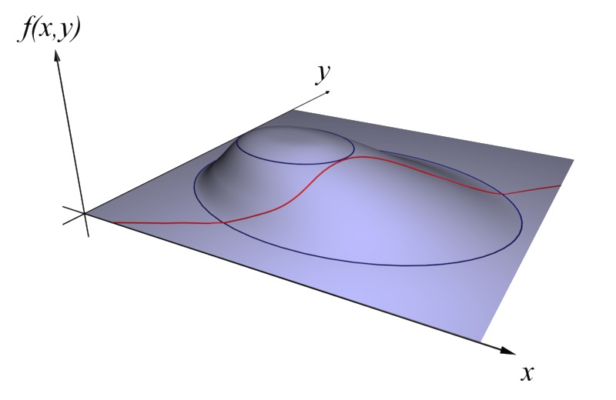
Governing equations Equilibrium equations
Example with the Gibbs function
The non-stoichiometric method
This becomes an optimisation problem where
Illustration in 2D
- Find an extremum of the function G(x,y), represented by the blue lines
- that satisfies the condition p_{l}*(x,y)=smthg represented by the red line
3 points satisfy the conditions
Notes:
----- Notes de la réunion (12/11/2014 12:11) -----
And on this simple example you find 3 such points, represented by the intersection of the lines

Slide 81
Governing equations Equilibrium equations
Example with the Gibbs function
The non-stoichiometric method
This becomes an optimisation problem where
Which is solved by introducing Lagrange multipliers such that
And the problem can be posed as a solution of a set of
(K + l) nonlinear equations
Notes:
----- Notes de la réunion (12/11/2014 12:11) -----
And on this simple example you find 3 such points, represented by the intersection of the lines

Slide 82
Governing equations Equilibrium equations
The non-stoichiometric method
Once the are determined, since T & P are constant, the mole fractions are
automatically deduced.
General procedure (Note: no need to provide reactions information !) :
The are tabulated.
The user provides a guess for enough ( ) - with the knowledge that
The can then be deduced from the previous K equations.
The unkown are calculated with those estimated and is evaluated.
If is « too far » from 1, a new guess for the is provided and the procedure reiterates with well chosen
Notes:
----- Notes de la réunion (12/11/2014 12:11) -----
You repeat this procedure until you find a set of mole fractions and lagrange multipliers that best satisfy these equations (to a user specified error tolerance)

Slide 83
4. Keywords in the cti format
Notes:
Let’s detail a little bit the difference bet CA & CH

Slide 84
Practical use
Data file
So… how is it written (format ‘.cti’) ?
It is composed of « entries » and « directives » recognized via keywords.

Slide 85
Practical use
Data file
So… how is it written (format ‘.cti’) ?
It is composed of « entries » and « directives » recognized via keywords.
A directive will tell the code how the entry parameters are to be interpreted.
For example, the ‘units’ directive

Slide 86
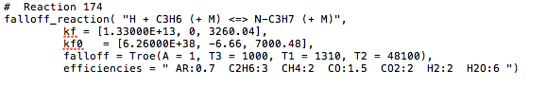
Practical use
Data file
So… how is it written (format ‘.cti’) ?
It is composed of « entries » and « directives » recognized via keywords.
An entry defines an object.
For example, a falloff reaction

Slide 87
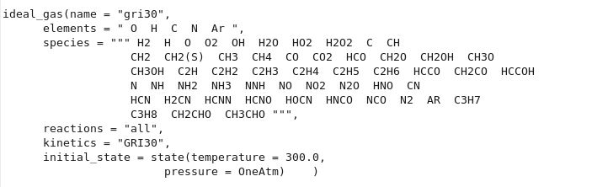
Practical use
Data file
So… how is it written (format ‘.cti’) ?
It is composed of « entries » and « directives » recognized via keywords.
Entries are composed of a series of fields that can be assigned values.
For example, ‘name’ or ‘elements’ for a phase
87

Slide 88
5. Equations in the cti
Notes:
Let’s detail a little bit the difference bet CA & CH

Slide 89
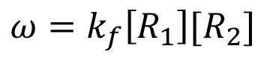
Practical use
Data file
Simple forward constant rates coefficients
k_{f} = A T^{b} e^{-E/RT}
If the reaction is irreversible
$$ω=k_{f}\left[R_{1}\right][R_{2}]$$
Net reaction rate
net_rates_of_progress
Arrhenius forward coefficient
forward_rate_constants
R₁, R₂ = reactants 1 and 2

Slide 90
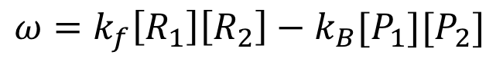
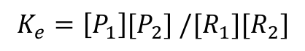
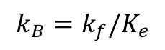
Practical use
Data file
Simple forward constant rates coefficients
k_{f} = A T^{b} e^{-E/RT}
If the reaction is reversible
$$ω=k_{f}\left[R_{1}\right]\left[R_{2}\right]−k_{B}[P_{1}][P_{2}]$$
Forward reaction rate
forward_rates_of_progress
Forward reaction rate
reverse_rates_of_progress
Arrhenius backward coefficient
with
Equilibrium constants
equilibrium_constants
$$k_{B}=k_{f}/K_{e}$$
and
$$K_{e}=\left[P_{1}\right][P_{2}] /[R_{1}][R_{2}]$$
R₁, R₂ = reactants 1 and 2 and P₁, P₂ = products 1 and 2

Slide 91
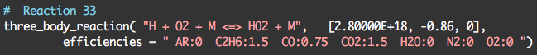
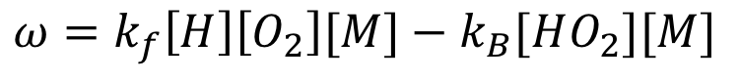
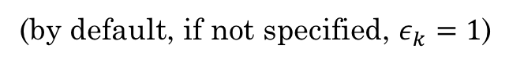
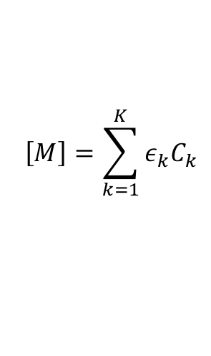
Practical use
Data file
$$ω=k_{f}\left[H\right]\left[O_{2}\right][M]−k_{B}[HO_{2}][M]$$
$$\left[M\right]={\sum_{k=1}^{K}{ε_{k}C_{k}}}_{ }$$
with
(by default, if not specified, $ε_{k}=1$)
efficiencies

Slide 92
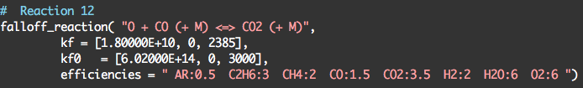
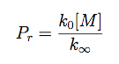
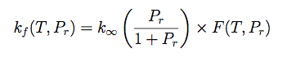
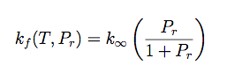
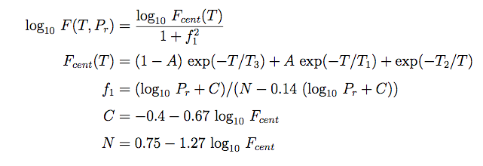
Practical use
Data file
Coefficient with third body
(low pressure)
Coefficient without third body
(high pressure)
Lindemann fall-off
Troe fall-off

Slide 93
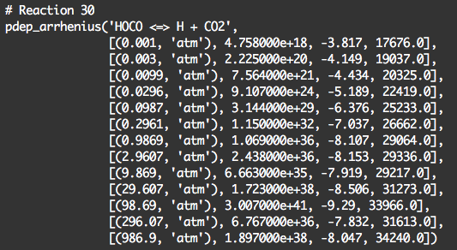
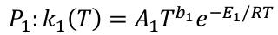
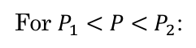
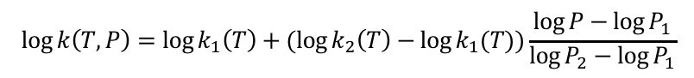
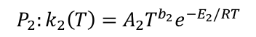
Practical use
Data file
$$P_{1}:k_{1}\left(T\right)=A_{1}T^{b_{1}}e^{−E_{1}/RT}$$
$$P_{2}:k_{2}\left(T\right)=A_{2}T^{b_{2}}e^{−E_{2}/RT}$$
For $P_{1}<P<P_{2}$:
$$\log{k\left(T,P\right)=\log{k_{1}\left(T\right)+(\log{k_{2}\left(T\right)−\log{k_{1}(T))\frac{\log{P−\log{P_{1}}}}{\log{P_{2}}−\log{P_{1}}}}}}}$$

